Slide 1
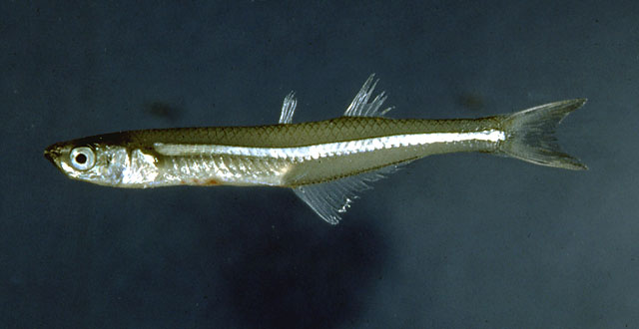
Basal Acanthopterygians

Slide 2
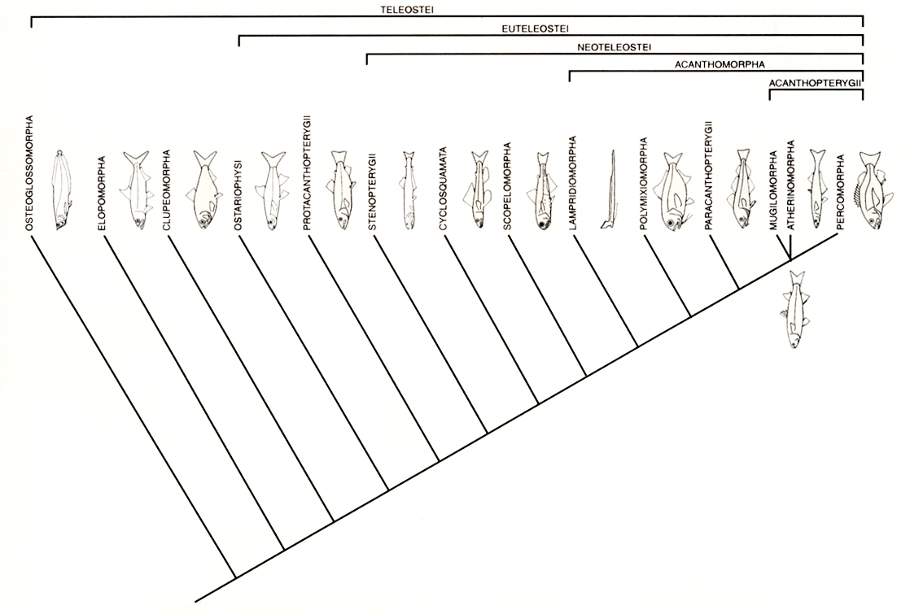

Slide 3
Superoder Acanthopterygii
Spiny-finned fishes - perches, basses, tunas, flounders, etc.
13,500 species
Marine, freshwater, and anadromous
  (23% strictly freshwater)
Dominate shallow water marine habitats
Dominate in warmer freshwater lakes

Slide 4
Pelvic and Pectoral Fins?

Slide 5
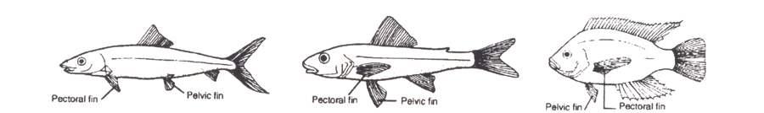
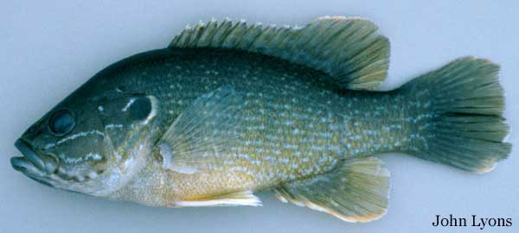
Superorder Acanthopterygii
Pelvic fins thoracic or jugular
Vertically aligned, midlateral pectorals

Slide 6
Dorsal and Caudal Fins?

Slide 7
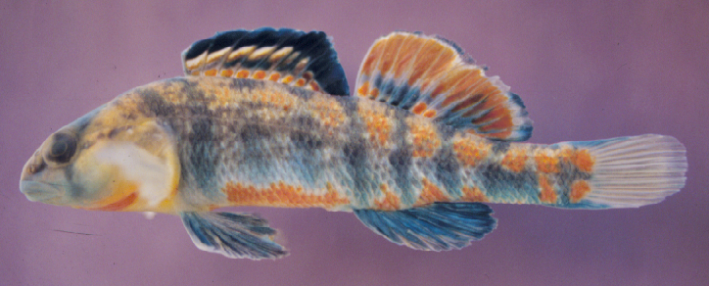
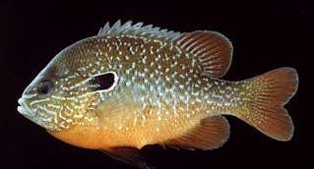
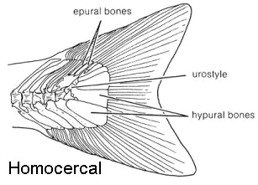
Superorder Acanthopterygii
Two dorsal fins
  Spiny (anterior)
  Soft (posterior)
Homocercal tail

Slide 8
Swimbladder?

Slide 9
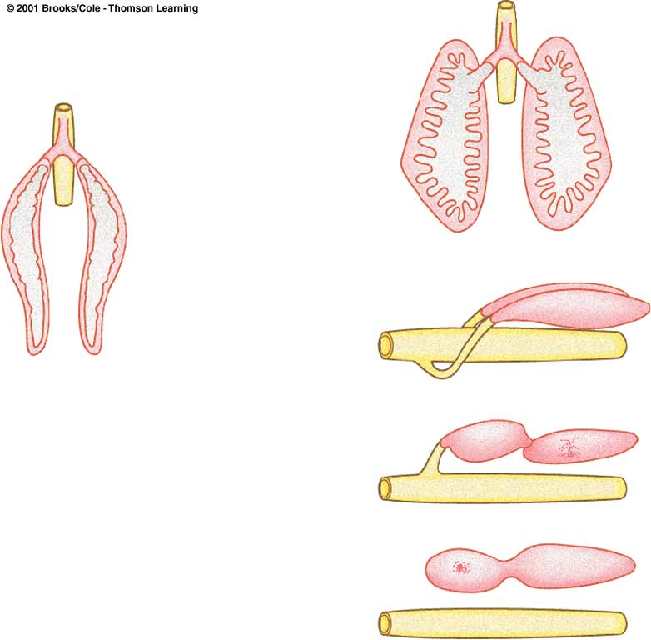
Superorder Acanthopterygii
Swim bladder physoclistous or absent

Slide 10
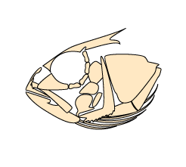
Superorder Acanthopterygii
Premaxilla protractile

Slide 11
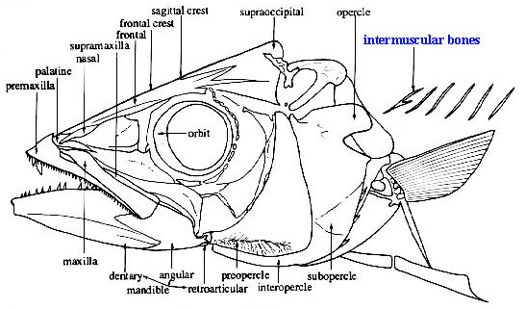
Superorder Acanthopterygii
Toothless maxillae
No adipose fin

Slide 12
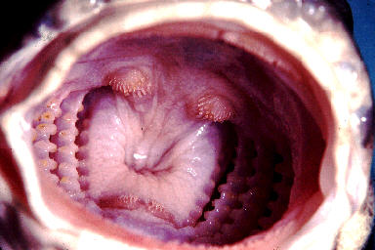
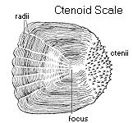
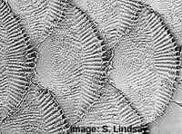
Superorder Acanthopterygii
Pharyngeal teeth present
Ctenoid scales (most)

Slide 13
Superorder Acanthopterygii
Predator defense specializations
  Spines

Slide 14
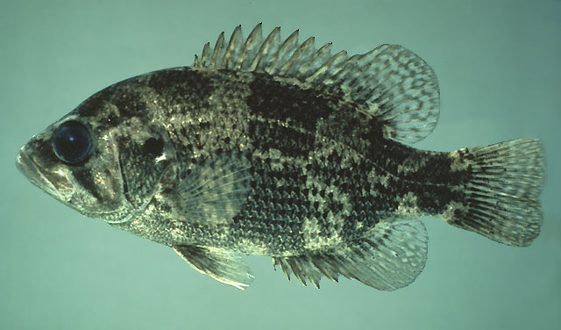
Superorder Acanthopterygii
Spiny Rayed Fins

Slide 15
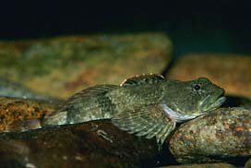
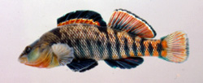
Acanthopterygii adaptations
Predator defense specializations
  Spines
  Coloration & markings

Slide 16
Acanthopterygii adaptations
Predator defense specializations
  Spines
  Coloration & markings
  Maneuverability
    swim bladder
    fin position
    fin strength

Slide 17
Acanthopterygii adaptations
Feeding specializations
  protrusible premaxilla (upper jaw)
  teeth
    jaw & mouth
    pharyngeal
  maneuverability
    fin position & strength
    swim bladder

Slide 18
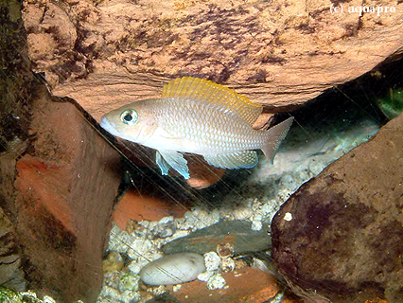
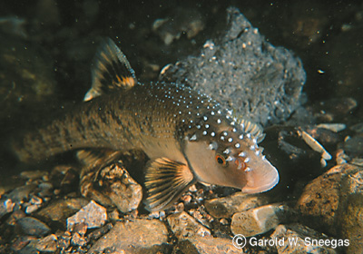
Acanthopterygii adaptations
Reproductive specializations
  territoriality
  elaborate courtship
  behavioral parental care

Slide 19
Superorder Acanthopterygii
Subdivision Teleostei
Infradivision Euteleostei
Superorder Acanthopterygii
Series Mugilomorpha
Order Mugiliformes
Series Atherinomorpha
Order Cyprinodontiformes
Order Atheriniformes
Order Beloniformes
Series Percomorpha

Slide 20
Acanthopterygii Classification
14 orders, 250 families
Three Series
  Mugilomorpha
  Atherinomorpha
  Percomorpha
Basal
Acanthomorphs
Advanced
Acanthomorphs

Slide 21
Superorder Acanthopterygii
Subdivision Teleostei
Infradivision Euteleostei
Superorder Acanthopterygii
Series Mugilomorpha
Order Mugiliformes
Series Atherinomorpha
Order Cyprinodontiformes
Order Atheriniformes
Order Beloniformes
Series Percomorpha

Slide 22
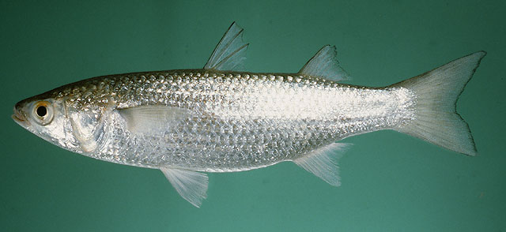
Series Mugilomorpha
Marine, anadromous, some FW (77 species)
Two dorsals (spinous and soft)
Pectorals fins set high on body and vertical
Thoracic pelvics
Cycloid scales (or intermediate)
No adipose fin

Slide 23
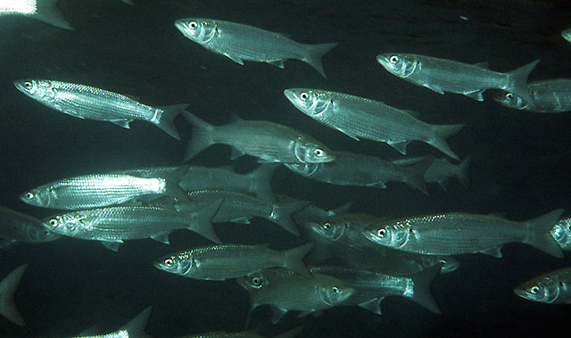
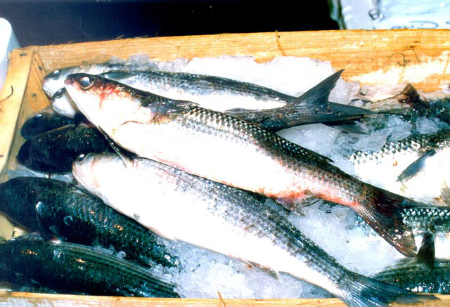
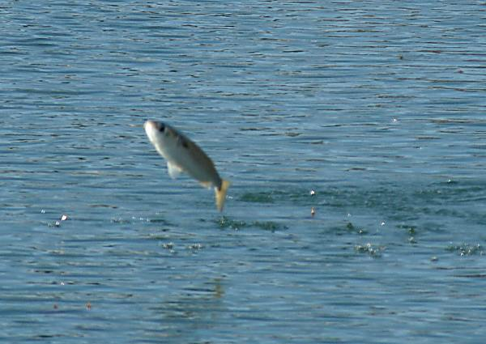
Order Mugiliformes
Family Mugilidae

Slide 24
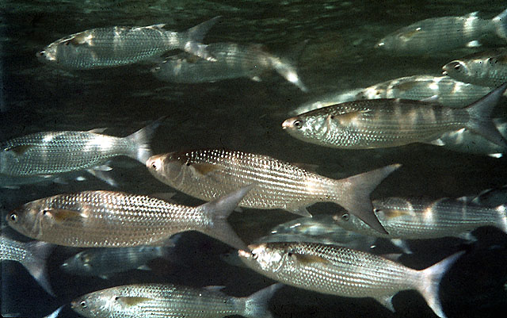
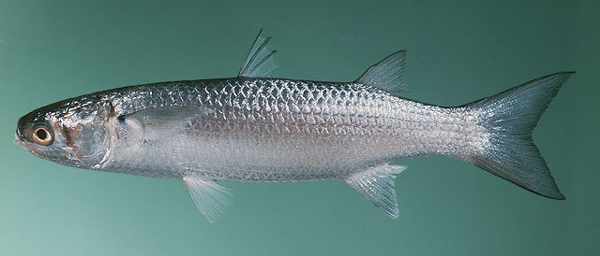
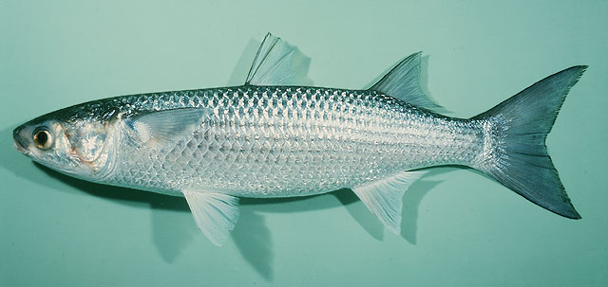

Slide 25
Superorder Acanthopterygii
Subdivision Teleostei
Infradivision Euteleostei
Superorder Acanthopterygii
Series Mugilomorpha
Order Mugiliformes
Series Atherinomorpha
Order Cyprinodontiformes
Order Atheriniformes
Order Beloniformes
Series Percomorpha

Slide 26
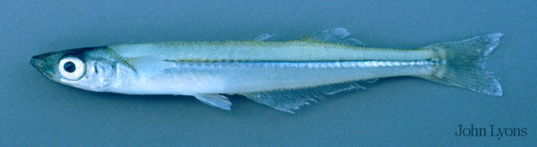
Series Atherinomoprha
Generally small, surface-oriented fishes
Large eyes, flattened heads, upturned mouths
Dorsal fins set far back on the body
Primarily marine, but some FW
Physoclistic swimbladder
Ctenoid scales usually absent
No spines on opercular bones

Slide 27
Order Atheriniformes
230+ species, three orders
Freshwater and shallow water marine
Slender, elongate body
Planktivorous fishes

Slide 28
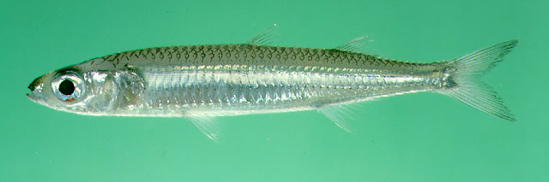
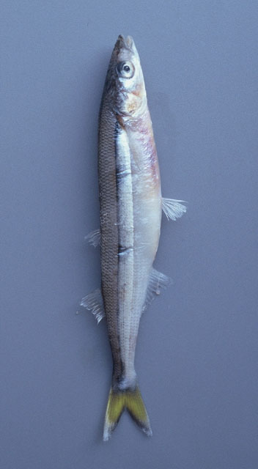
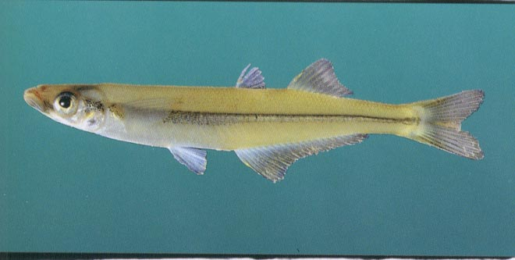
Order Atheriniformes
Family Atherinopsidae
Family Atherinidae

Slide 29
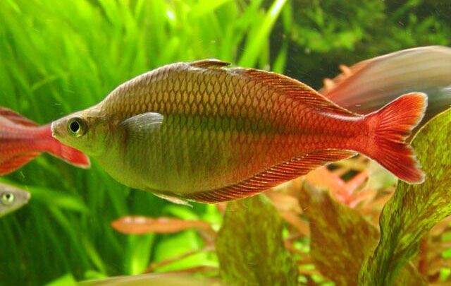
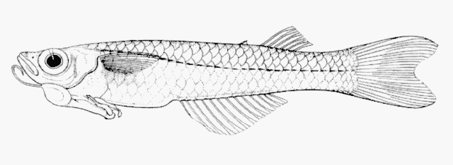
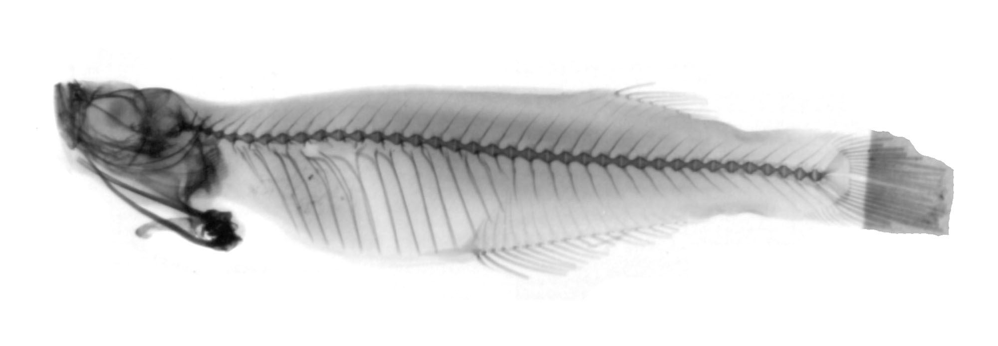
Order Atheriniformes
Family Melanotaeniidae
Family Phallostethidae

Slide 30
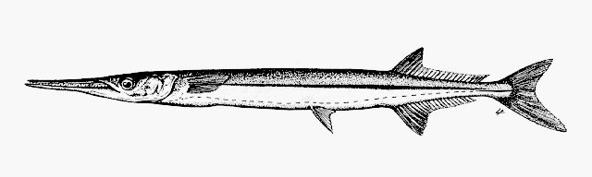
Order Beloniformes
Silvery marine fishes (191 species)
Epipelagic fishes
Roughly equal dorsal and anal fins located far back on the body,
Low-running lateral line
Abdominal pelvic fins

Slide 31
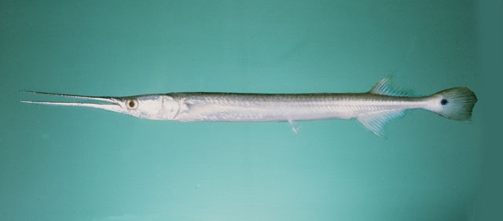
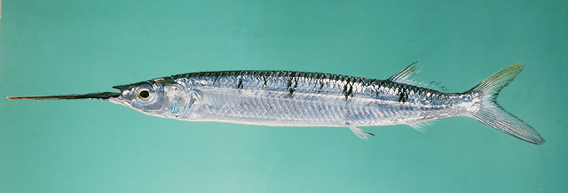
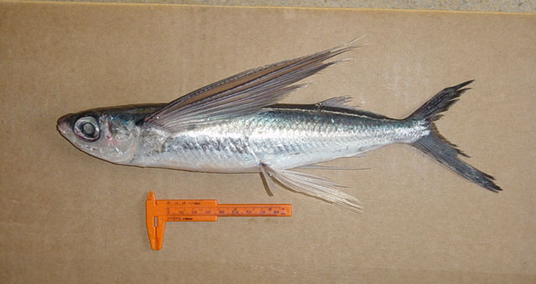
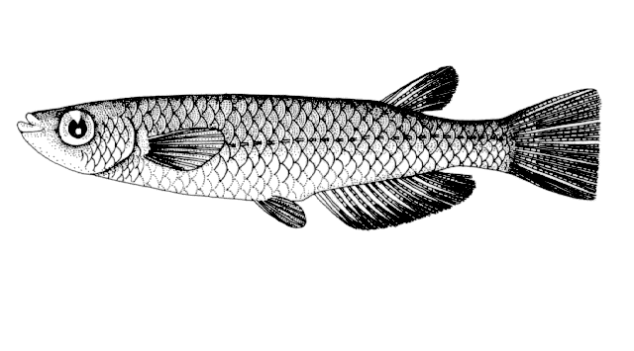
Order Beloniformes
Family Belonidae
Family Hemirhamphidae
Family Adrianichthyidae
Family Exocoetidae

Slide 32
Order Cyprinodontiformes
Most are FW, others are estaurine
Wide range of salinities and temperatures
  42C
  160ppt salinities
Small (<15cm)
807 species
Single dorsal fin

Slide 33
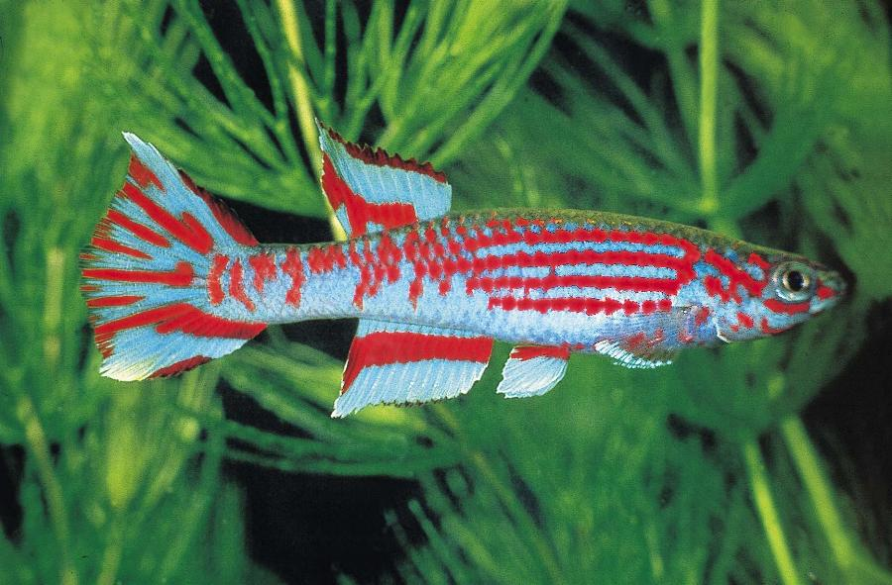
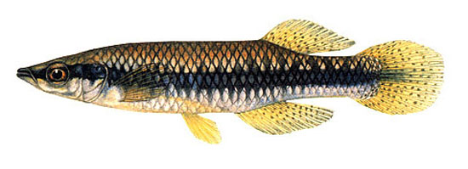
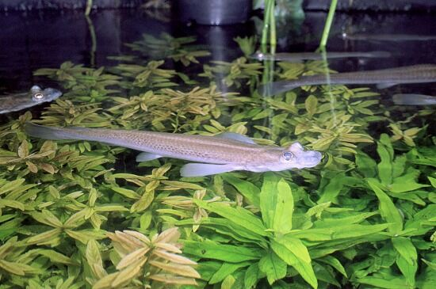
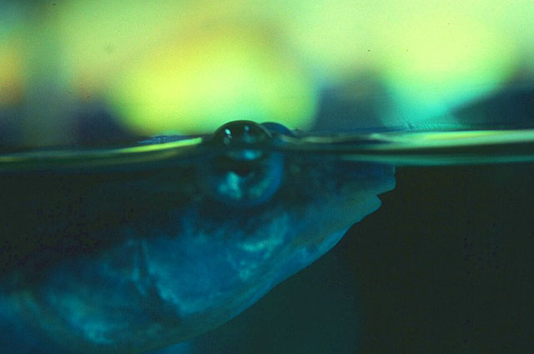
Order Cyprinodontiformes
Family Aplocheilidae
Family Fundulidae
Family Anablepidae

Slide 34
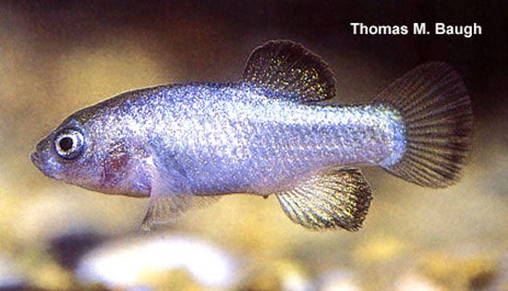
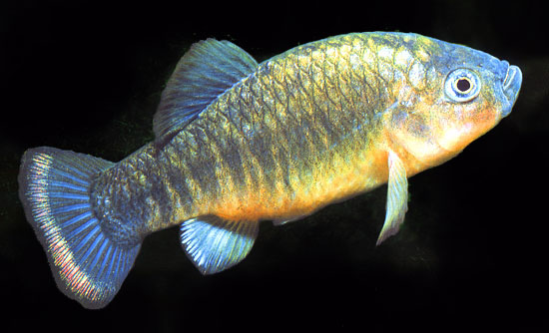
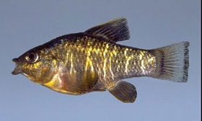
Order Cyprinodontiformes
Family Cyprinodontidae

Slide 35
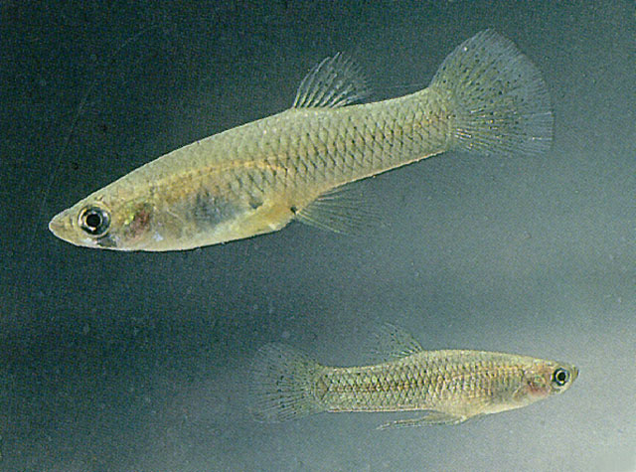
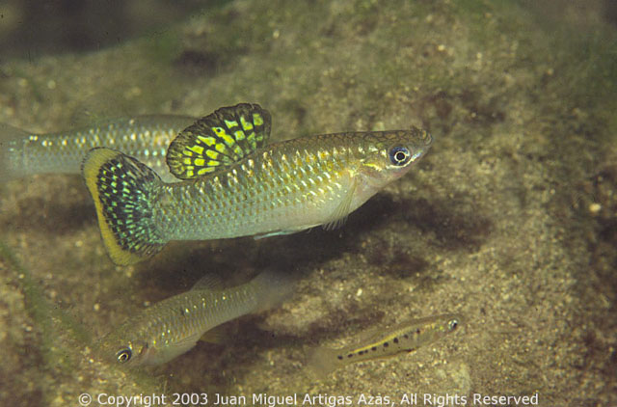
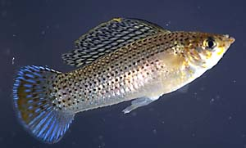
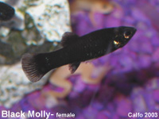
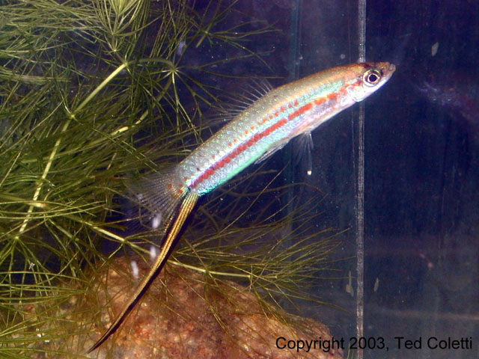
Order Cyprinodontiformes
Family Poecilidae

